Slide 1
Information Extraction

Slide 2
Handling Unstructured Data
In today's data-driven world, organizations have unprecedented access to vast amounts of data.
However, this data typically exists in an unstructured format, making analysis and interpretation difficult.
Much of today's data is unstructured, such as text documents, emails, social media posts, and web pages. Information Extraction plays a crucial role in handling and making sense of this unstructured data.
Businesses and organizations can unlock valuable insights and make data-driven decisions by automatically extracting and transforming unstructured data into structured information.
Moreover, by extracting and analyzing information across different sources, it enables knowledge discovery, revealing hidden patterns and trends that may provide strategic advantages to organizations.

Slide 3
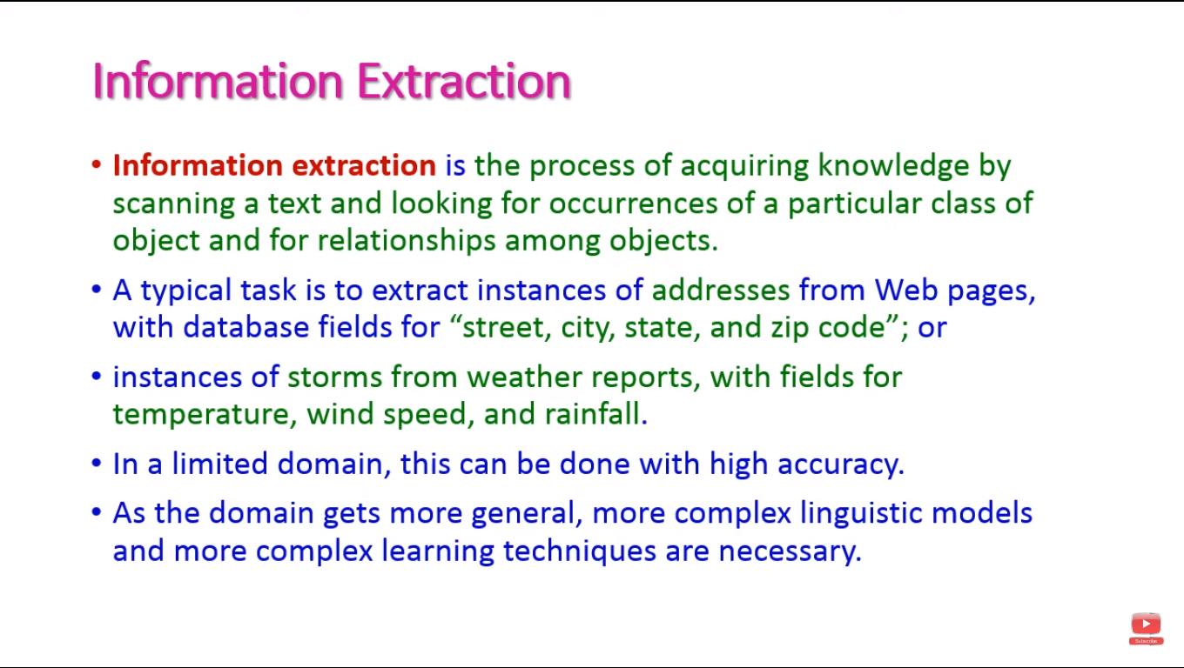

Slide 4
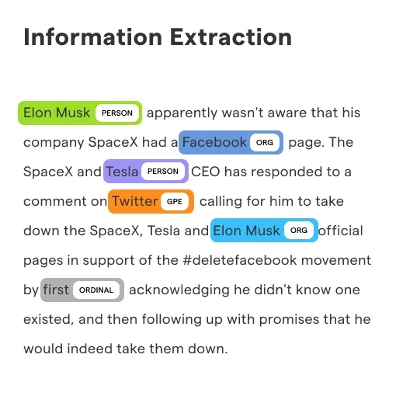
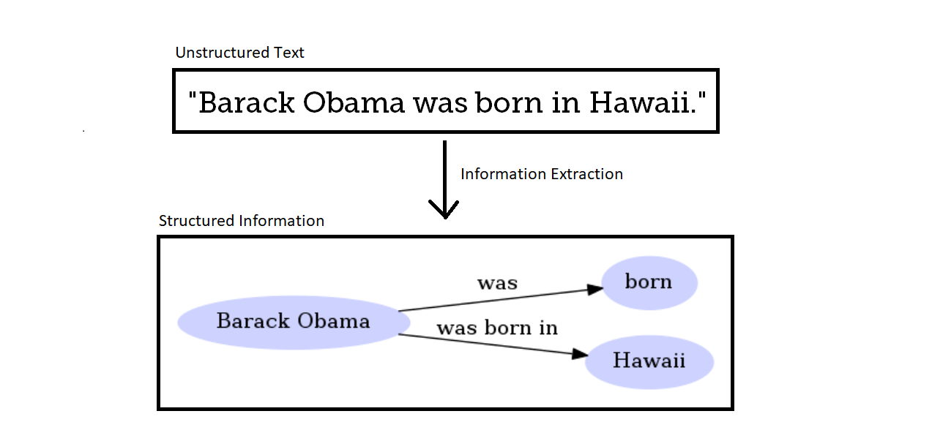

Slide 5


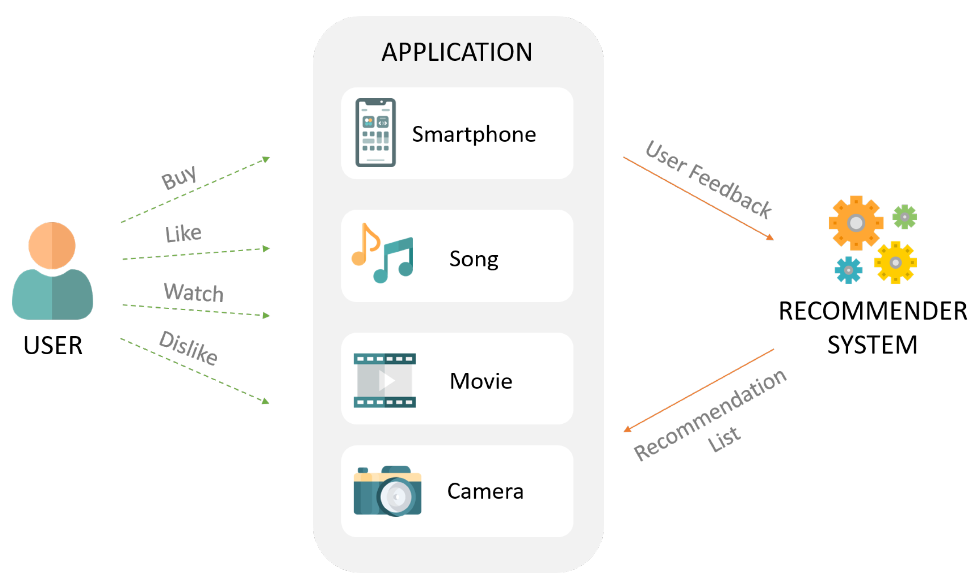

Slide 6
Applications
Business intelligence
-identifying emerging trends and patterns, forecasting future outcomes
Financial investigation
-it facilitates efficient financial analysis and helps uncover fraudulent activities.
Scientific research
-analyzing vast amounts of scientific literature and data.
Healthcare records management
-helps healthcare organizations to maintain their records easily, making it simpler to draw insights, and improve patient care

Slide 7
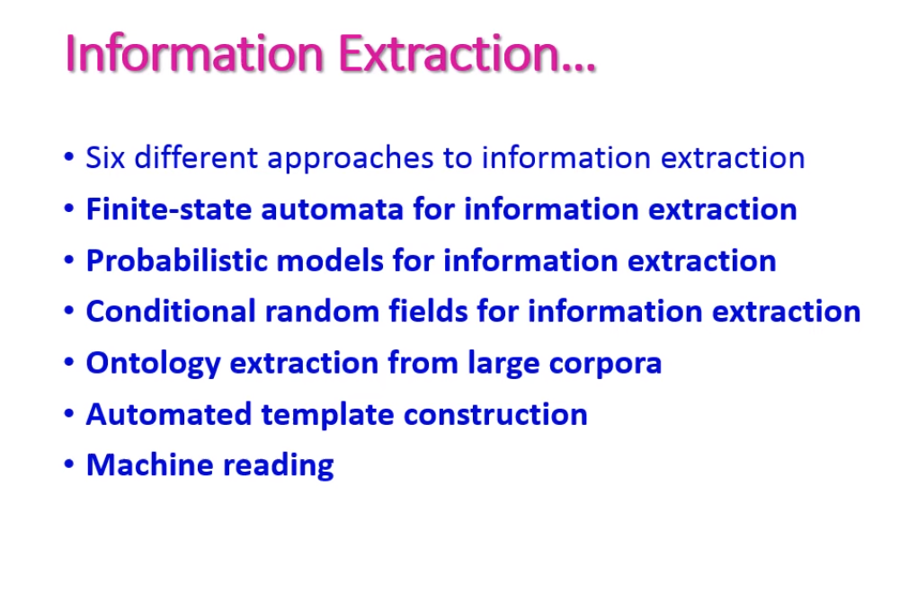

Slide 8
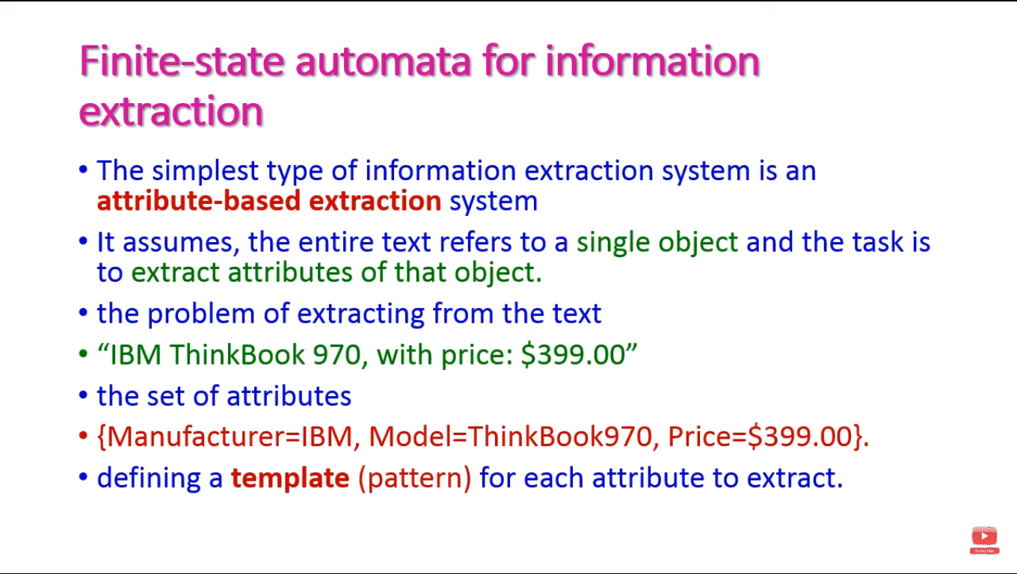

Slide 9
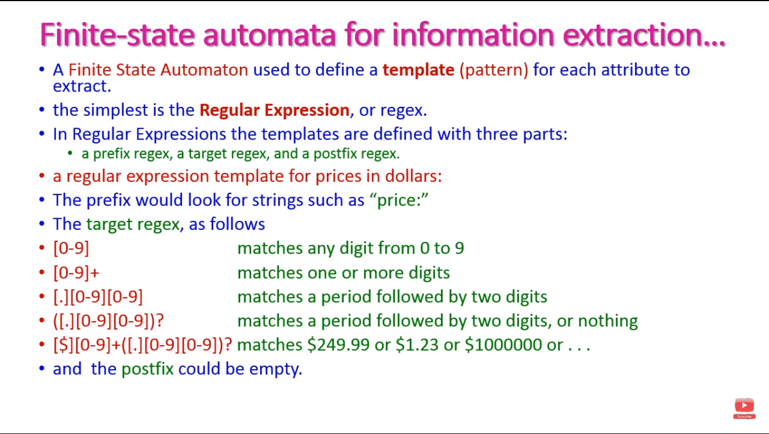

Slide 10
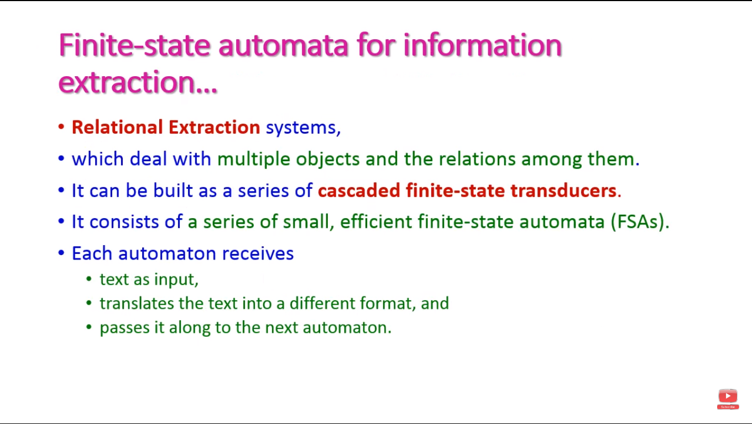
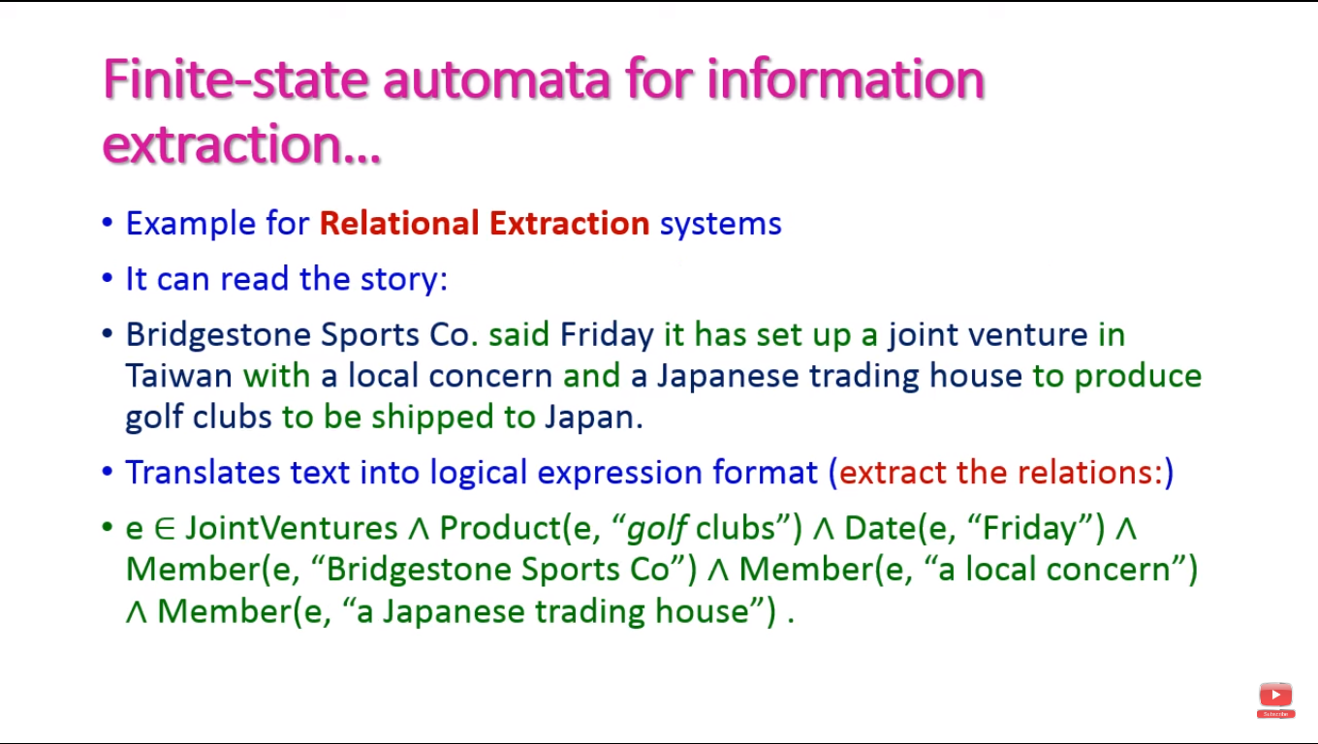

Slide 11
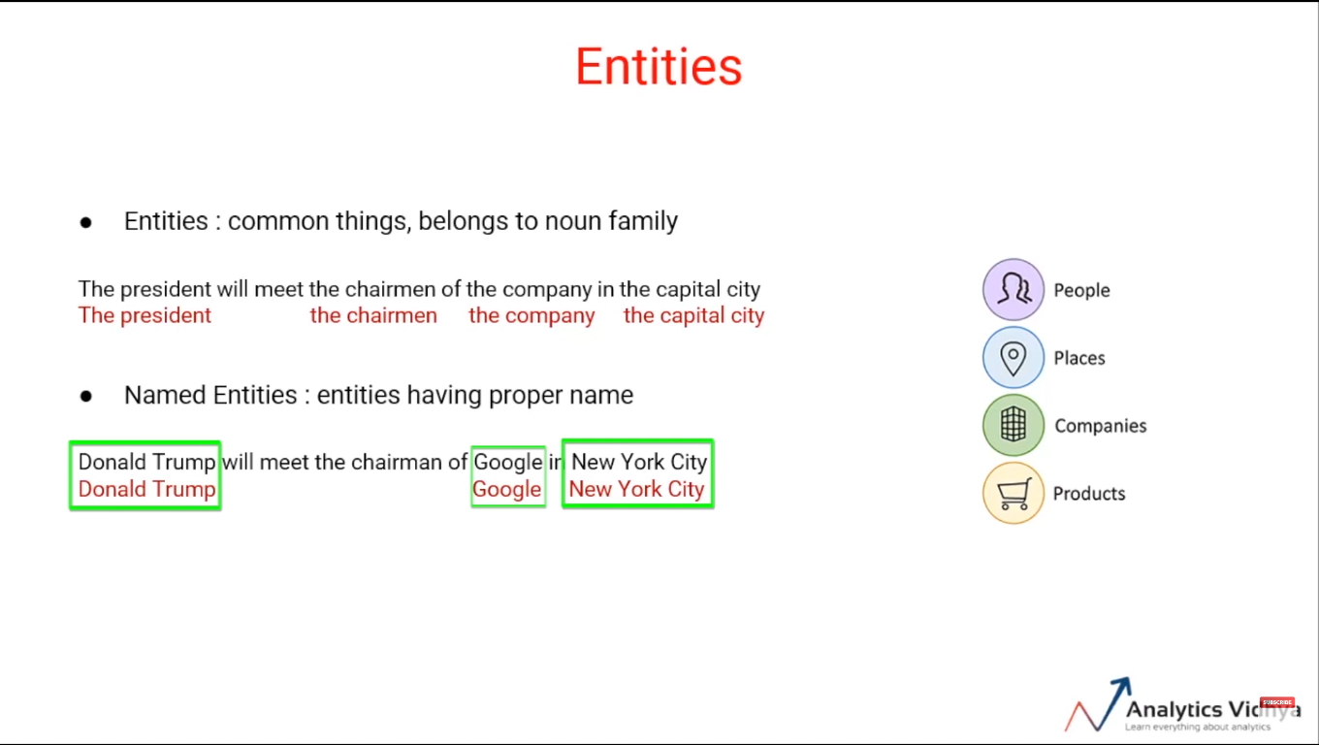

Slide 12
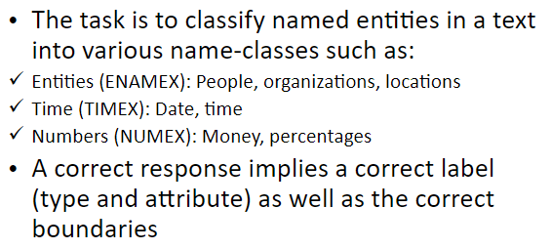
Named Entity Recognition
Named-entity recognition (NER) is a subtask of information extraction that seeks to locate and classify named entities mentioned in unstructured text into pre-defined categories such as person names, organizations, locations, and so on.

Slide 13
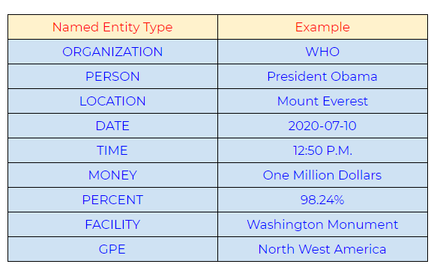
Commonly used types of named entity

Slide 14
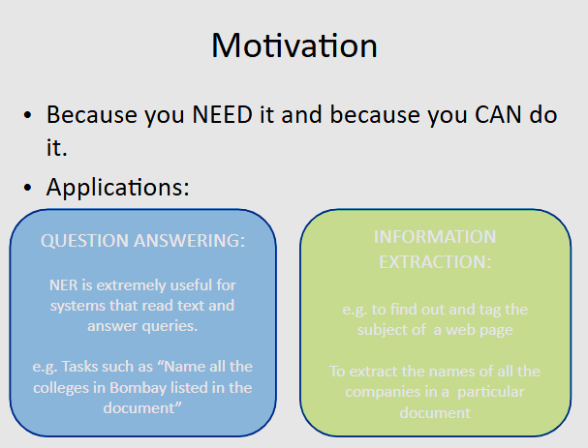
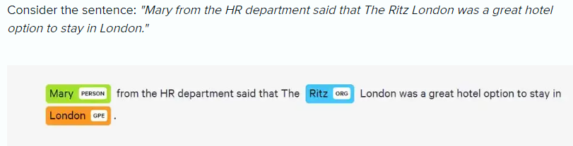

Slide 15
